Slide 1


General Biology lab
Al-Karkh University for Science
Collage of Science
Microbiology Department
Dr. Rawa Abdul Redha Aziz
Ph.D Antibiotics/ Molecular biology
Laboratory Staff:
1. Lecturer Dr. Rawa Abdul Redha Aziz
2. L. assistant Sura Alaa Saud
3. L. assistant Gada Readh
Supervised by:
1. Prof. Munira Ch. Ismaeel
2. Ass. Prof. Israa AJ Ibrahim

Slide 2

Syllabus Content
Subject | Lab No.
Safety in laboratory | Lab 1
Sterilization and disinfectant | Lab 2
Staining bacteria: simple stain technique | Lab 3
Gram stain | Lab 4
Wet slide, using wet mount to observe fungi | Lab 5
Medial preparation | Lab 6
Isolation bacteria from environment | Lab 7
Interpretation the results and colony diagnosis | Lab 8
Fungi culture and identification | Lab 9
Interpretation the results | Lab 10
Protozoa | Lab 11
Helminthes | Lab 12
Control of microorganisms | Lab 13

Slide 3


Lab 1: Safety in Laboratory

Slide 4
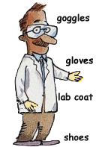
Follow all instructions carefully:
1. Treat all microorganisms as potential pathogens.
While the majority of microorganisms are not pathogenic to humans and have never been shown to cause illness, under unusual circumstances a few microorganisms that are not normally pathogenic can act as pathogens. Treat all microorganisms—especially unknown cultures—as if they were pathogenic.
***A student who has a compromised immune system or has had a recent extended illness should talk with the instructor before working in the microbiology laboratory.

Slide 5
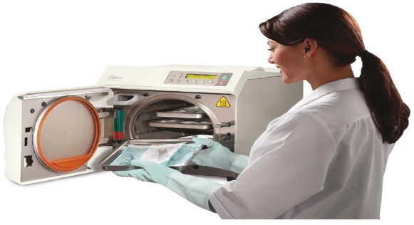
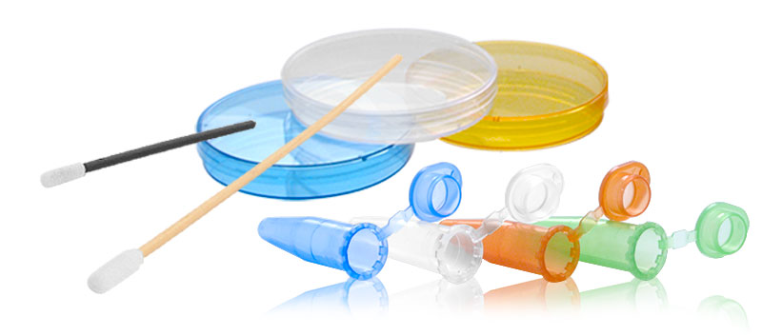
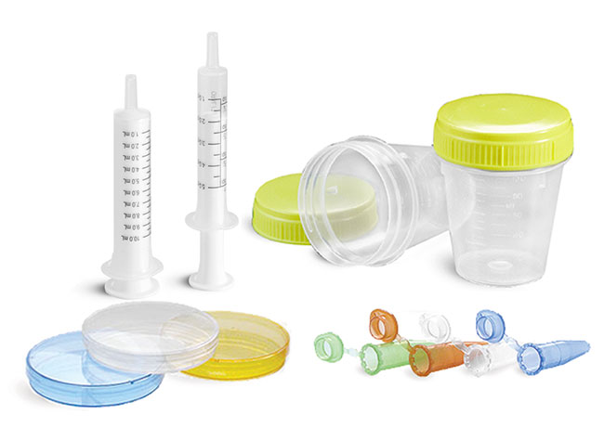
2. Sterilize equipment and materials
All materials, media, tubes, plates, loops, needles, pipetes, and other items used for culturing microorganisms should be sterilized by autoclaving. Otherwise, use commercially sterilized products. Understand the operation and safe use of all equipment and materials needed for the laboratory.

Slide 6


3. Keep work areas clean and tidy at all times
-Do not put books, bags, and personal staff on the working areas.
-Use a disinfectant, such as a 10% bleach or 70% ethanol solution, to wipe down benches and work areas both before and after working with cultures.
-Also be aware of the possible dangers of the disinfectant, as 70% ethanol can catch fire around open flame or high heat sources.
Bleach, if spilled, can ruin your clothing. Either alcohol or bleach can be dangerous if splashed in the eyes. Students should know where the nearest eyewash station and sink are located.

Slide 7
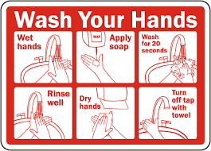
4. Wash your hands
Use a disinfectant soap to wash your hands before and after working with microorganisms. Non-disinfectant soap will remove surface bacteria and can be used if disinfectant soap is not available. Gloves may be worn as extra protection.

Slide 8



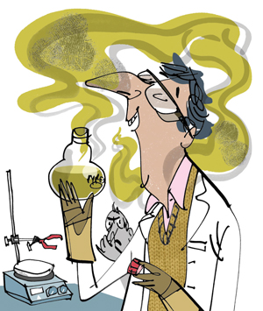
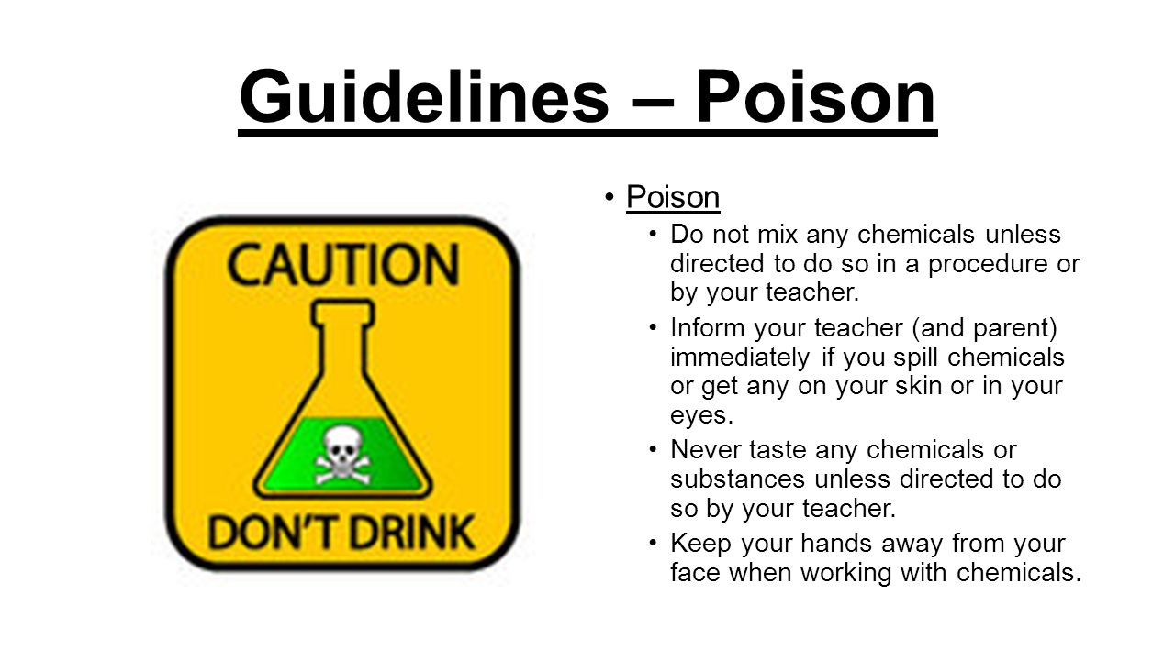
5. Never pipette by mouth. Use pipette bulbs or pipetting devices for the aspiration and dispensing of liquid cultures.
6. Never eat or drink in the lab
7. Label everything clearly
All cultures, chemicals, disinfectant, and media should be clearly and securely labelled with their names and dates. If they are hazardous, label them with proper warning and hazardous information.

Slide 9
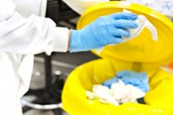
8. Autoclave or disinfect all waste material.
All items to be discarded after a class, such as culture tubes, culture plates, swabs, toothpicks, wipes, disposable transfer needles, and gloves, should be placed in a biohazard autoclave bag and autoclaved 30 to 40 minutes at 121° C at 20 pounds of pressure. If no autoclave is available and you are not working with pathogens, the materials can be covered with a 10% bleach solution and allowed to soak for at least 1 to 2 hours.

Slide 10
9. Clean up spills with care
Cover any spills or broken culture tubes with a 70% ethanol or 10% bleach solution; then cover with paper towels. After allowing the spill to sit with the disinfectant for a short time, carefully clean up and place the materials in a biohazard autoclave bag to be autoclaved. Wash the area again with disinfectant. Never pick up glass fragments with your fingers or stick your fingers into the culture itself; instead, use a brush and dustpan. If working with animal or plant pathogens, keep the area clear and notify your instructor.

Slide 11
